Slide 1



Introduction to coding with R and GitHub
Becky Heath
IPB University
30th August 2024

Slide 2


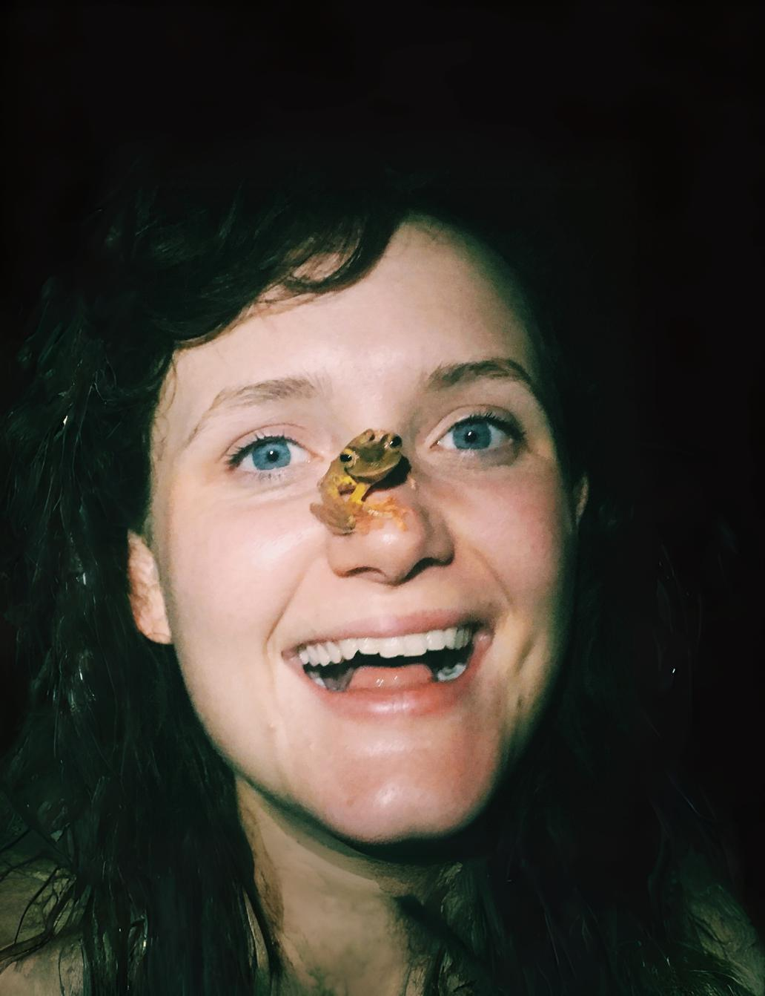
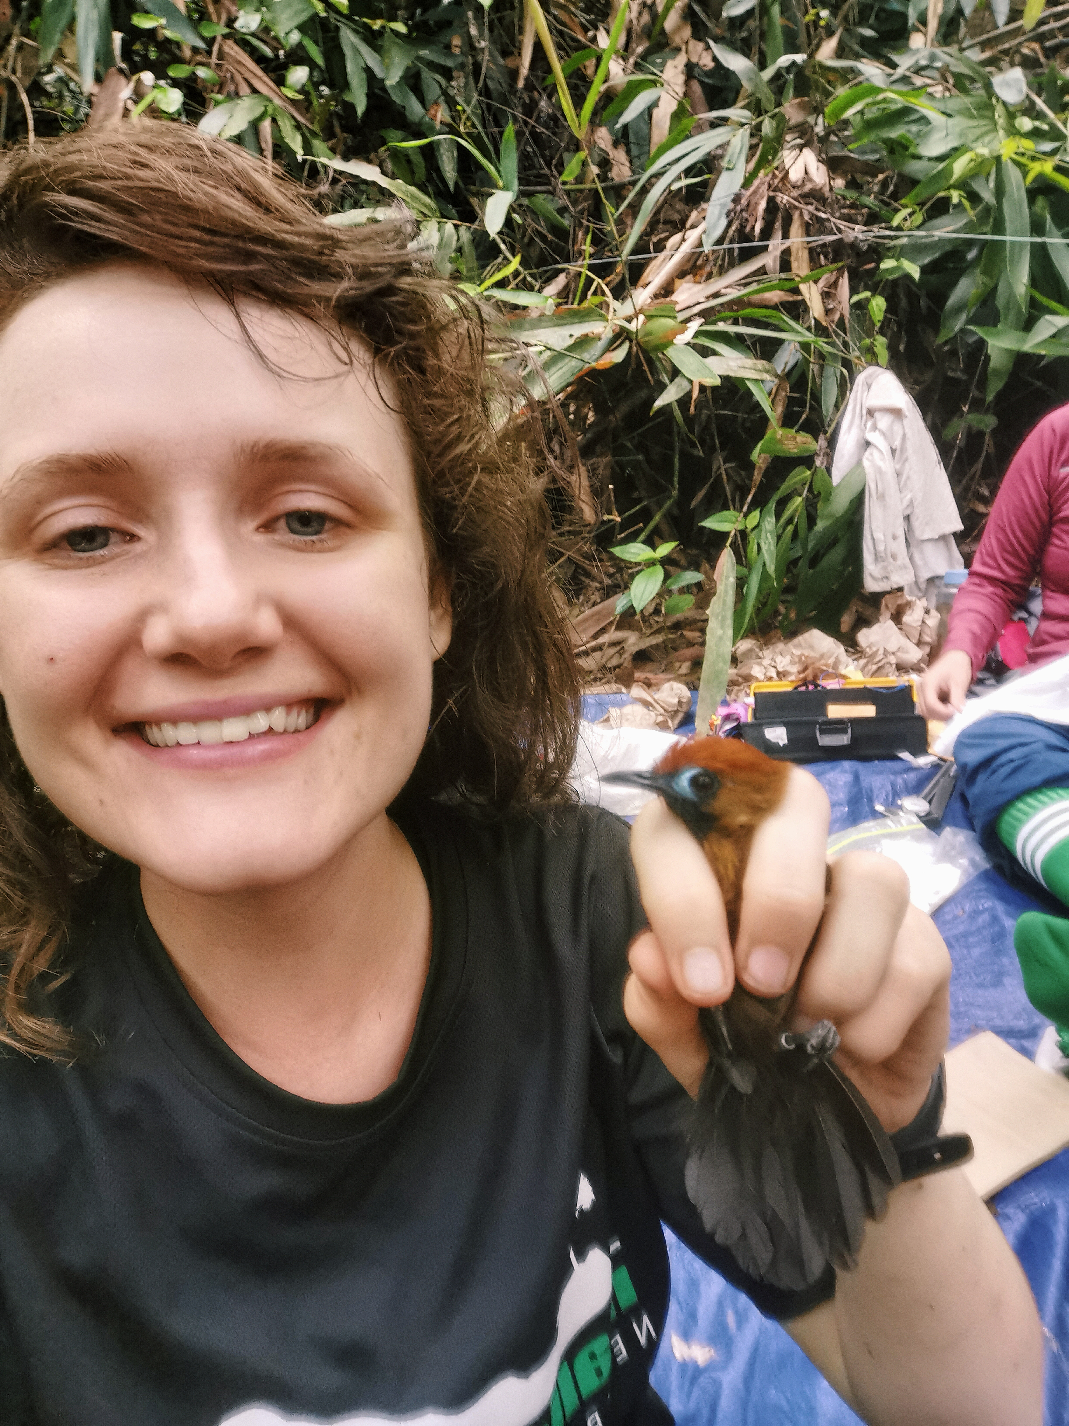
Selamat Pagi
Postdoctoral research associate working in the Museum of Zoology at the University of Cambridge in collaboration with IPB university
I work on the RERTA project with industrial and smallholder palm oil plantations to develop better sustainability strategies along waterways
@Becky_Heath rh862@cam.ac.uk

Slide 3
Overview
Introduction to coding and R
Introduction to GitHub
Plan for the rest of the session
Where to find help
@Becky_Heath rh862@cam.ac.uk

Slide 4
Introduction to coding and R
Introduction to coding and R
Introduction to GitHub
Plan for the rest of the session
Where to find help
@Becky_Heath rh862@cam.ac.uk

Slide 5

What do we mean by coding?
Writing code is essentially writing a list of instructions for a computer to follow.
Computers operate using 1s and 0s so programming languages are used as a bridge between the user and the system.
Algorithms/scripts are just chunks of code that have been written to tell a computer how to accomplish certain tasks.
@Becky_Heath rh862@cam.ac.uk

Slide 6






Uses for coding in data science?
Clean, extract, or organise data
Automate tasks and do things more quickly
Create models and perform statistical analysis
Create reproducable analysis pipelines
Create professional data visualisations
Machine learning, big data, predictive modelling
@Becky_Heath rh862@cam.ac.uk

Slide 7

What about R?
R is the most commonly used programming language for data analysis in ecology and biosciences.
R is specifically designed for statistical analysis, so it’s particularly powerful with data visualisation, data manipulation, modelling and visualisation
It’s completely open source (free!)
@Becky_Heath rh862@cam.ac.uk

Slide 8

R vs. R studio?
A software platform for writing and using R scripts
Language
@Becky_Heath rh862@cam.ac.uk

Slide 9
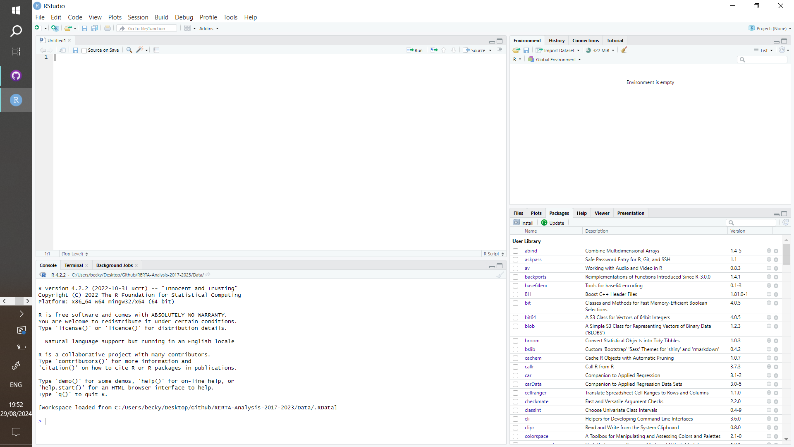
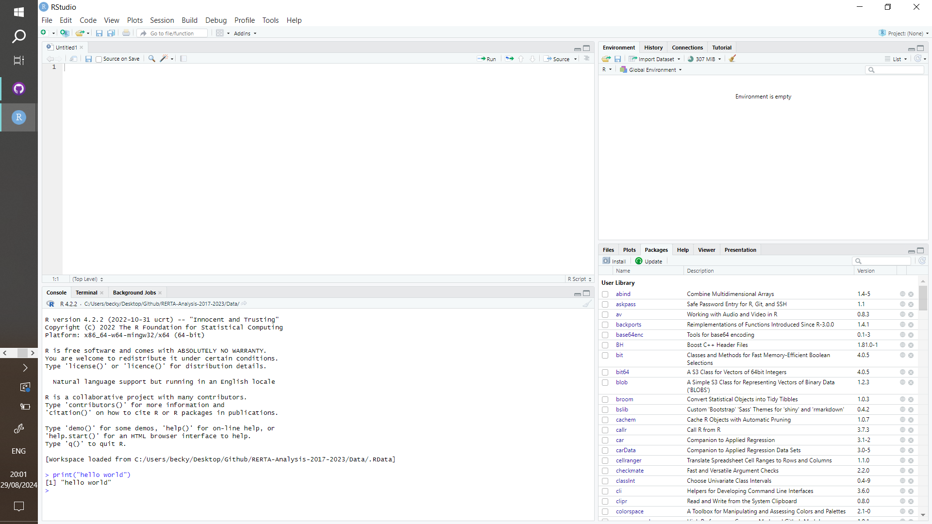
The R studio interface
This is the console, you can type instructions directly here.
Try:
print(“hello world”)
@Becky_Heath rh862@cam.ac.uk

Slide 10
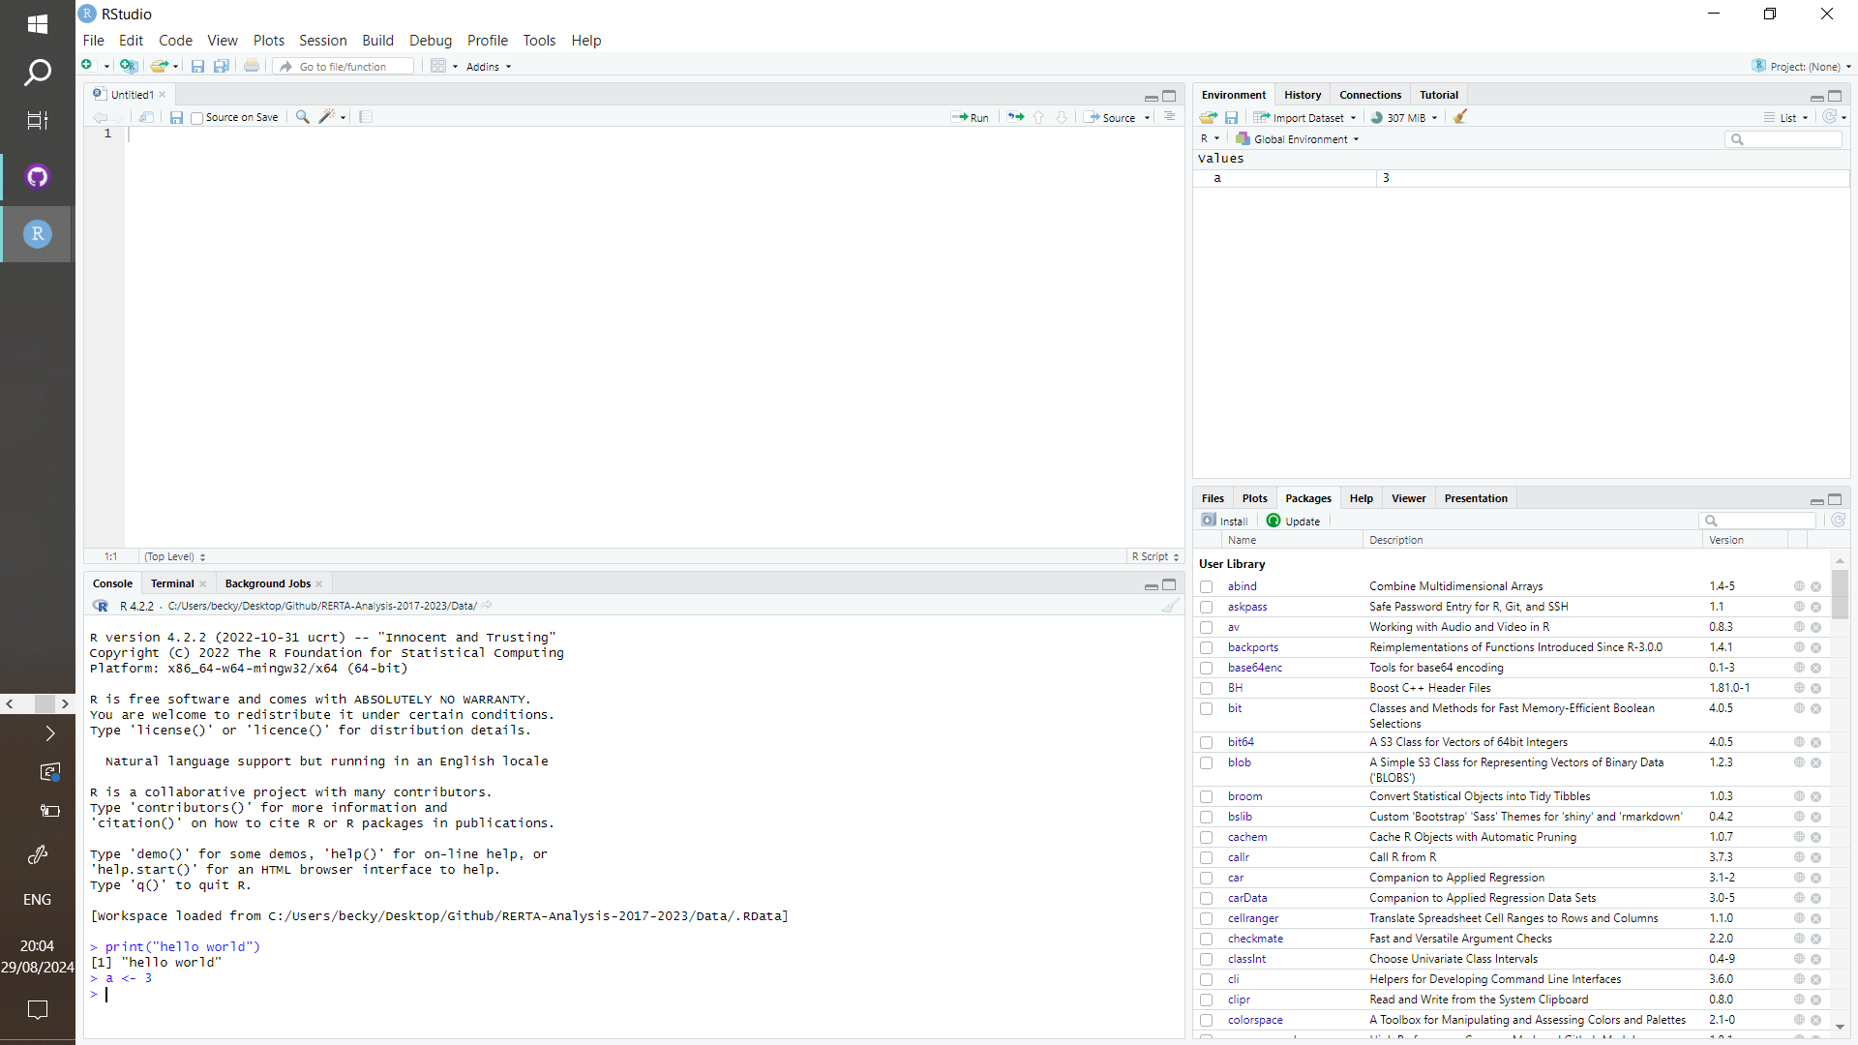
The R studio interface
We can also define variables here
try a <- 3
@Becky_Heath rh862@cam.ac.uk

Slide 11
The R studio interface
This shows what variables have been defined
@Becky_Heath rh862@cam.ac.uk

Slide 12

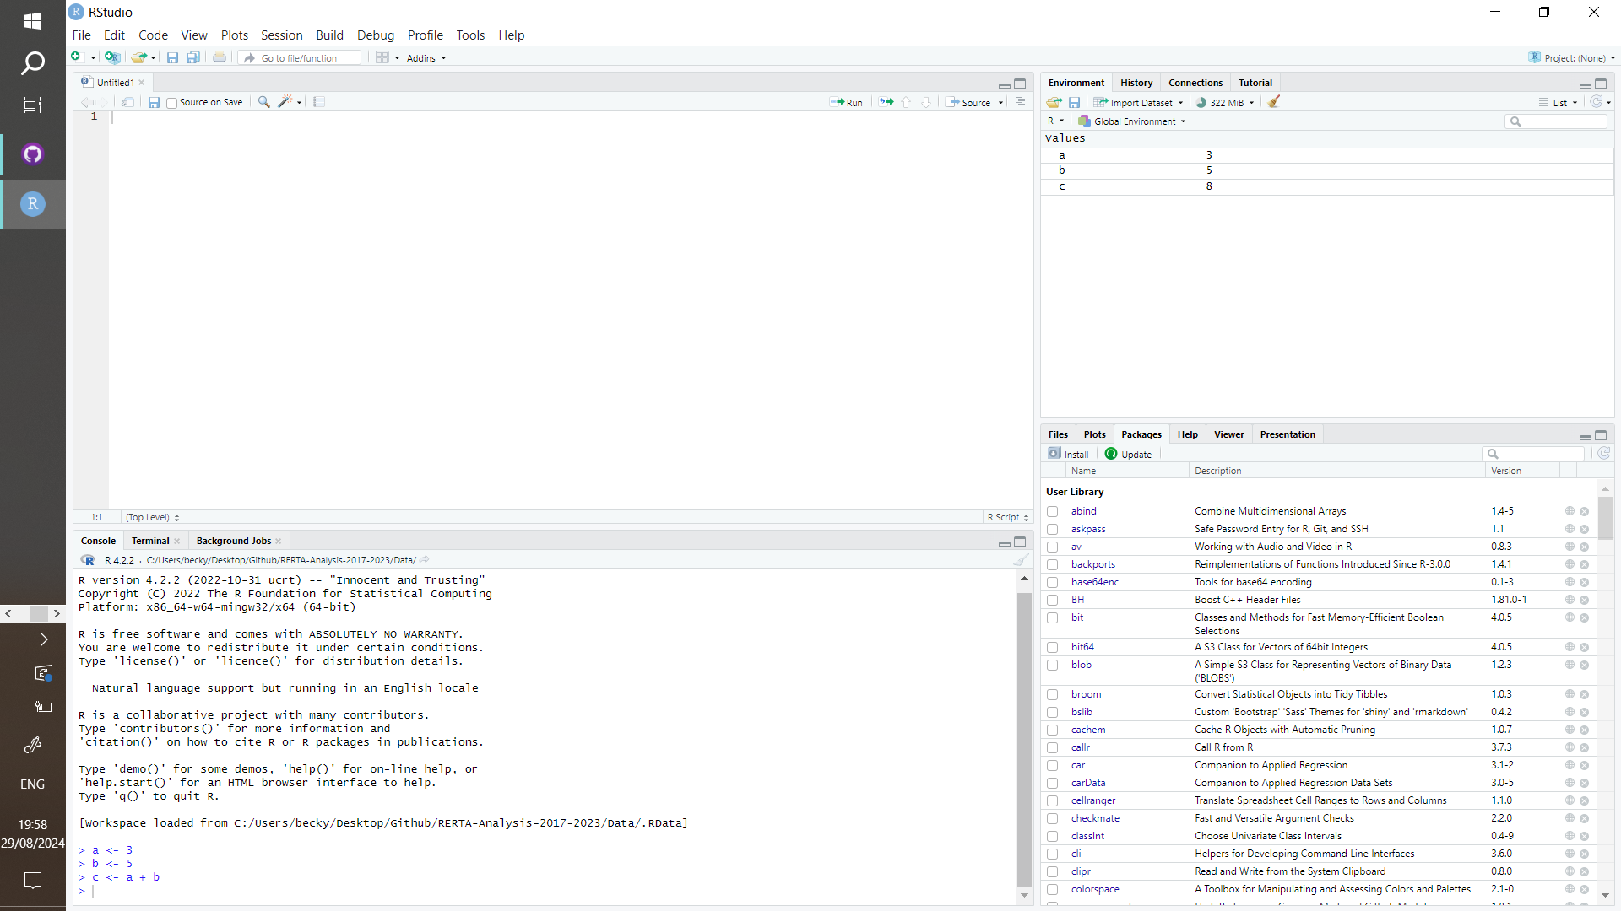
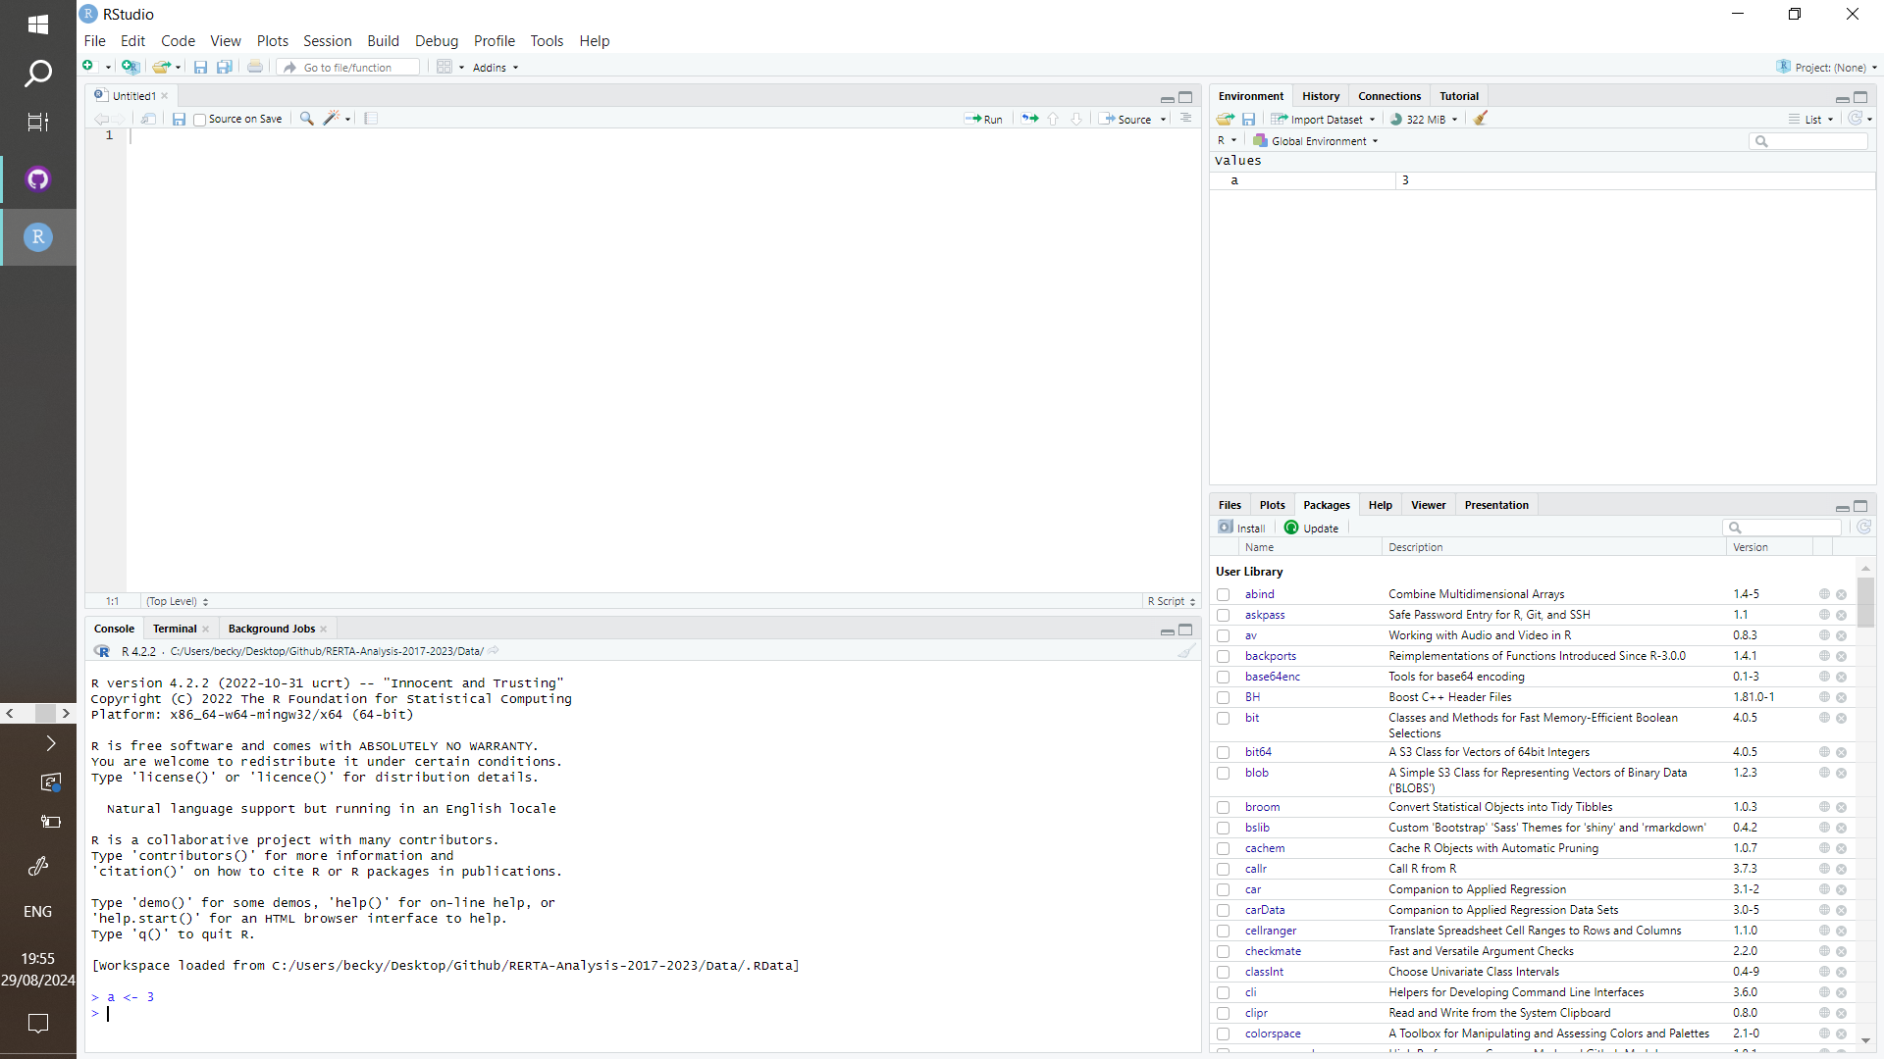
The R studio interface
This shows what variables have been defined
See that we wrote a new variable “b” and added it to “a” to make “c”
This is the console, you can type directly into here, try
“a <- 3”
@Becky_Heath rh862@cam.ac.uk

Slide 13
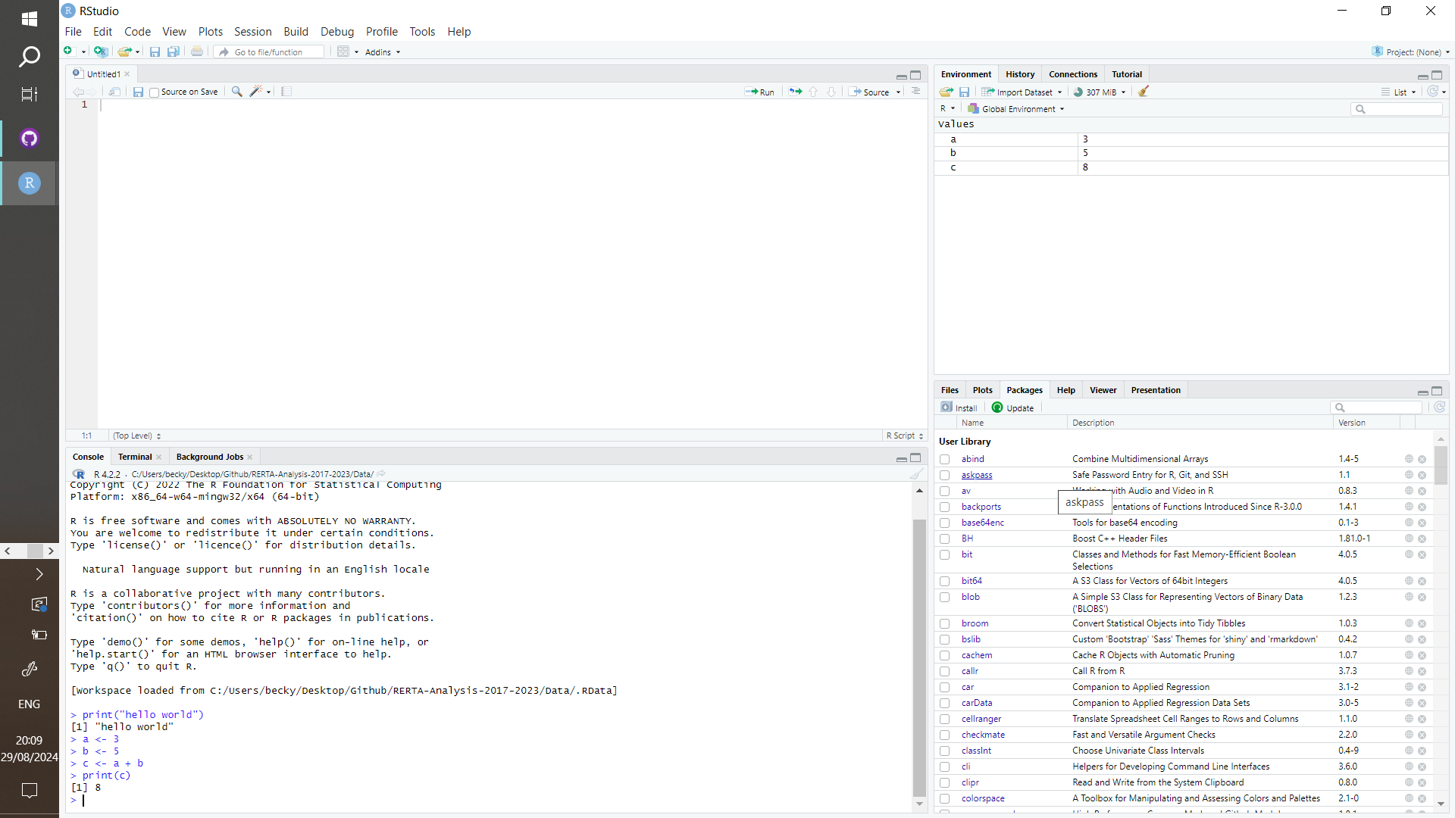
The R studio interface
This shows what variables have been defined
We can also feed variables into other functions such as print…
try:
print(c)
This is the console, you can type directly into here, try
“a <- 3”
@Becky_Heath rh862@cam.ac.uk

Slide 14
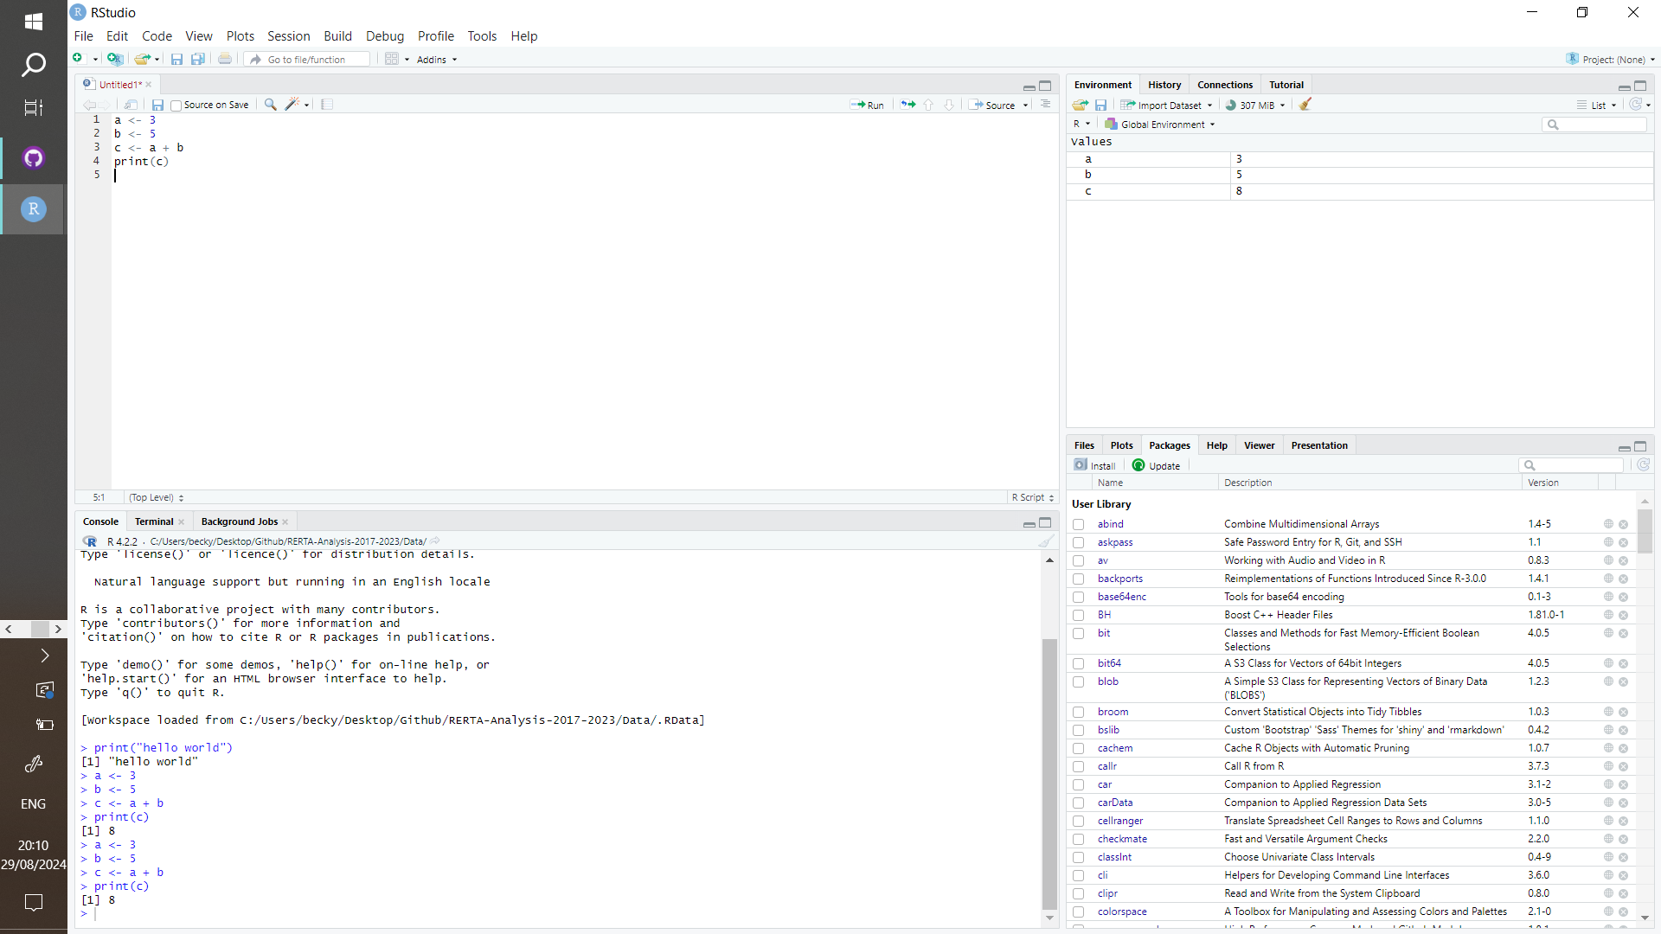
The R studio interface
This is the script, or recipe that you can save!
Try file, save to save the code you have written.
This shows what variables have been defined
This is the console, you can type directly into here, try
“a <- 3”
@Becky_Heath rh862@cam.ac.uk

Slide 15
The R studio interface
You can press “run” or ctrl+entr to run the code line by line, or highlight whole sections to run at once.
This shows what variables have been defined
This is the console, you can type directly into here, try
“a <- 3”
@Becky_Heath rh862@cam.ac.uk

Slide 16
The R studio interface
This little broom is used to clear the workspace… or delete all variables.
Make sure your final code runs after clearing to make sure you don’t miss anything
This shows what variables have been defined
This is the console, you can type directly into here, try
“a <- 3”
@Becky_Heath rh862@cam.ac.uk

Slide 17
Data Types using “typeof()”
Numeric
var1 <- 42
var2 <- 9.81
print(typeof(var1))
print(typeof(var2))
Integer
var1 <- 5L
var2 <- 15L
print(typeof(var1))
print(typeof(var2))
Data frame
var1 <- data.frame(
ID = 1:3,
Name = c("Alice", "Bob", "Charlie"),
Age = c(25, 30, 35))
print(typeof(var1))
Logical
var1 <- TRUE
var2 <- FALSE
print(typeof(var1))
print(typeof(var2))
Character
var1 <- “Hello, world!”
var2 <- “405”
print(typeof(var1))
print(typeof(var2))
Vector
var1 <- c(1,2,3,4,5)
var2 <- c(“1”, “hi”, “IPB”)
print(typeof(var1))
print(typeof(var2))

Slide 18
Common operators: What do they mean?
a <- 5
b <- 3
result <- (a + b) * b
print(result)
p <- TRUE
q <- FALSE
print(p & q)
vec1 <- c(1, 2, 3)
vec2 <- c(4, 5, 6)
result <- vec1 + vec2 print(result)
a <- 7
b <- 4
print(a > b)
x <- 10
x <- x + 5
print(x)

Slide 19
Common operators: Answers
a <- 5
b <- 3
result <- (a + b) * b
print(result)
24
p <- TRUE
q <- FALSE
print(p & q)
False
vec1 <- c(1, 2, 3)
vec2 <- c(4, 5, 6)
result <- vec1 + vec2 print(result)
c(5, 7, 9)
a <- 7
b <- 4
print(a > b)
TRUE
x <- 10
x <- x + 5
print(x)
15

Slide 20


Now try: Loading in a dataset
Go to:
https://ourcodingclub.github.io/tutorials/intro-to-r/

Slide 21
Introduction to GitHub
Introduction to R
Introduction to GitHub
Plan for the rest of the session
Where to find help
@Becky_Heath rh862@cam.ac.uk

Slide 22

GitHub
A platform for sharing, storing, and collaborating on code projects.
@Becky_Heath rh862@cam.ac.uk

Slide 23

Basics of what using GitHub is like
1) Create a repository
@Becky_Heath rh862@cam.ac.uk

Slide 24

Basics of what using GitHub is like
1) Create a repository
2) Upload to GitHub
@Becky_Heath rh862@cam.ac.uk

Slide 25

Basics of what using GitHub is like
1) Create a repository
2) Upload to GitHub
3) Make changes locally
@Becky_Heath rh862@cam.ac.uk

Slide 26

Basics of what using GitHub is like
1) Create a repository
2) Upload to GitHub
3) Make changes locally
4) Send updates to GitHub
@Becky_Heath rh862@cam.ac.uk

Slide 27


Basics of what using GitHub is like
1) Create a repository
2) Upload to GitHub
3) Make changes locally
4) Send updates to GitHub
5) Share/ collaborate
@Becky_Heath rh862@cam.ac.uk

Slide 28




Why bother using GitHub?
Keep a record of your work, revisit old versions.
Use other’s work for your own projects
Share code and collaborate more easily.
Online backup/ archive
Publish code in journals.
@Becky_Heath rh862@cam.ac.uk

Slide 29
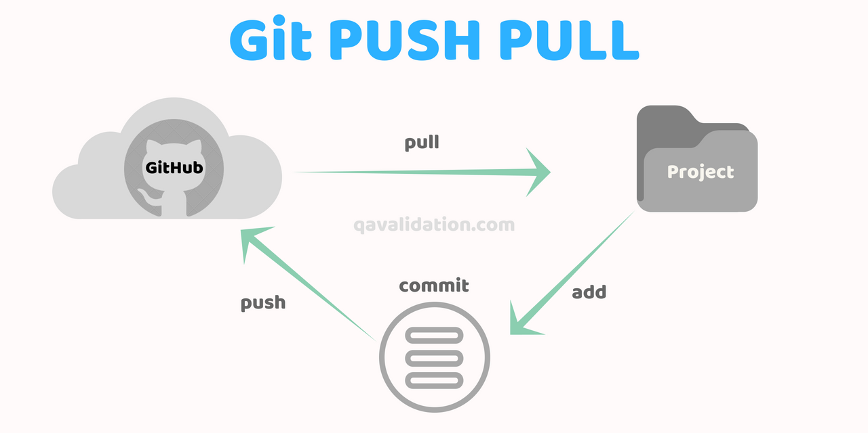
GitHub Core Concepts
@Becky_Heath rh862@cam.ac.uk

Slide 30
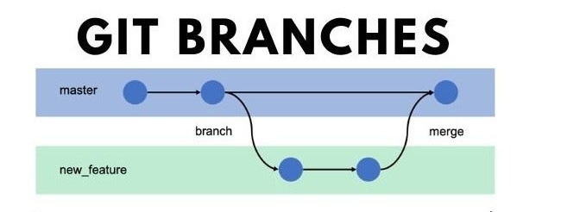
GitHub Core Concepts
@Becky_Heath rh862@cam.ac.uk

Slide 31

GitHub Desktop
GitHub Desktop is a friendly interface for working with GitHub repos
Here you can create a new repo locally, clone repos, and push to your GitHub account online
@Becky_Heath rh862@cam.ac.uk

Slide 32

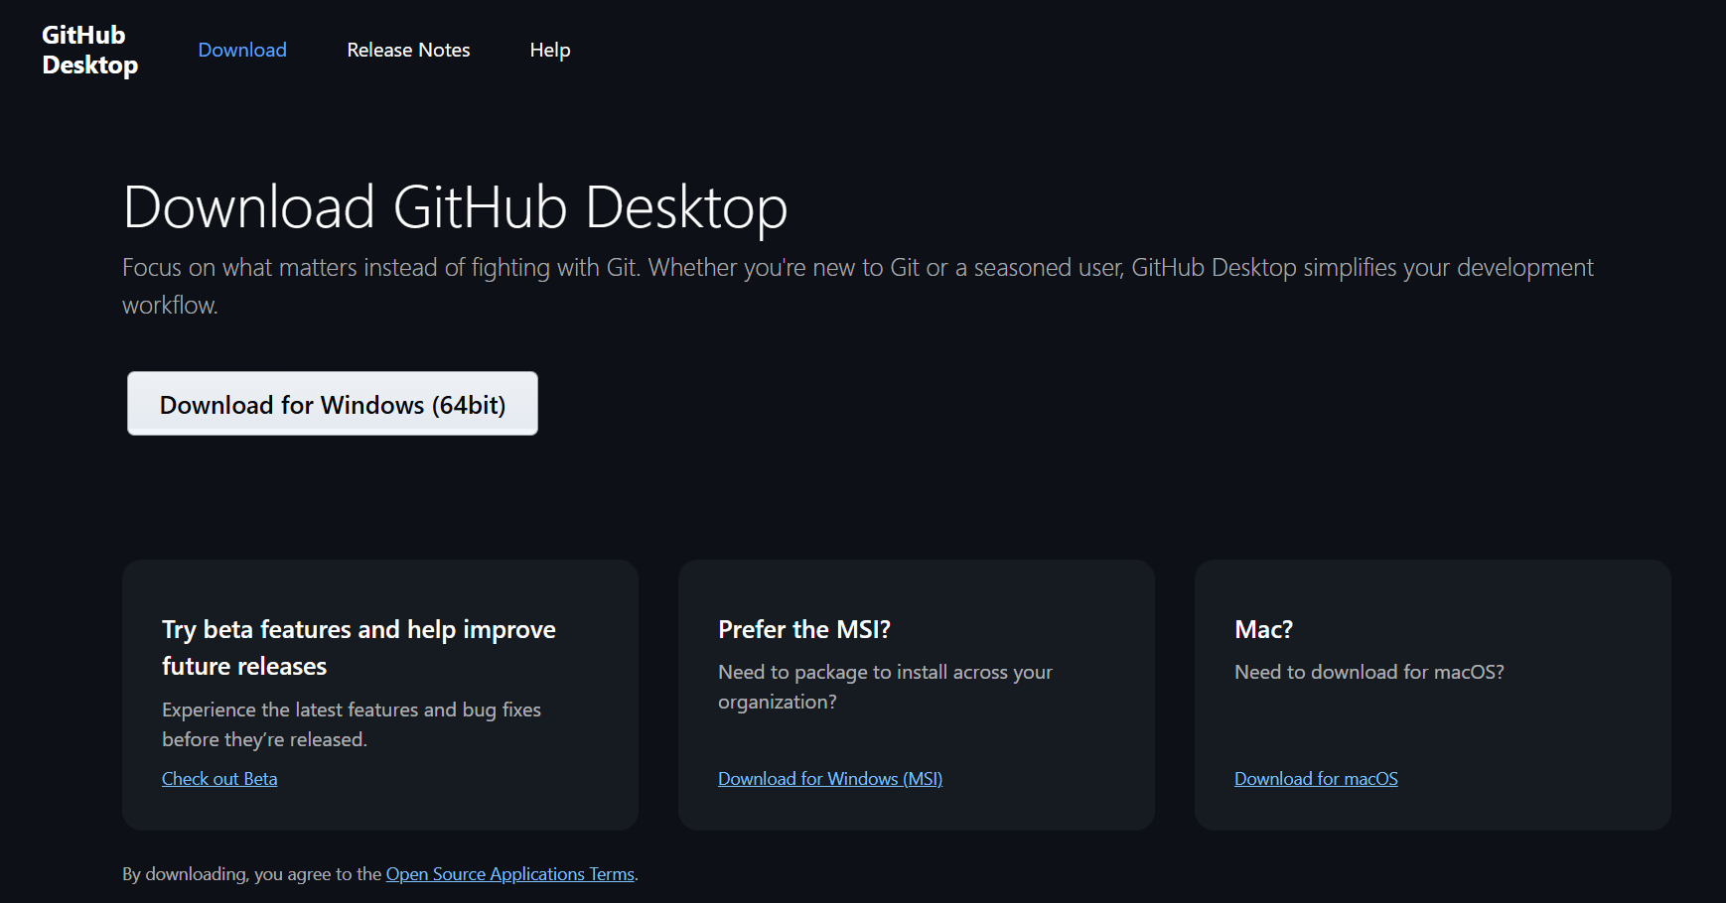
Getting started with GitHub
Download GitHub Desktop (this will also download Git)
https://docs.github.com/en/desktop/installing-and-authenticating-to-github-desktop/setting-up-github-desktop#
@Becky_Heath rh862@cam.ac.uk

Slide 33

Getting started with GitHub
2) Authenticate by signing in (you’ll need to create an account if you don’t have one
https://docs.github.com/en/desktop/installing-and-authenticating-to-github-desktop/authenticating-to-github-in-github-desktop
@Becky_Heath rh862@cam.ac.uk

Slide 34
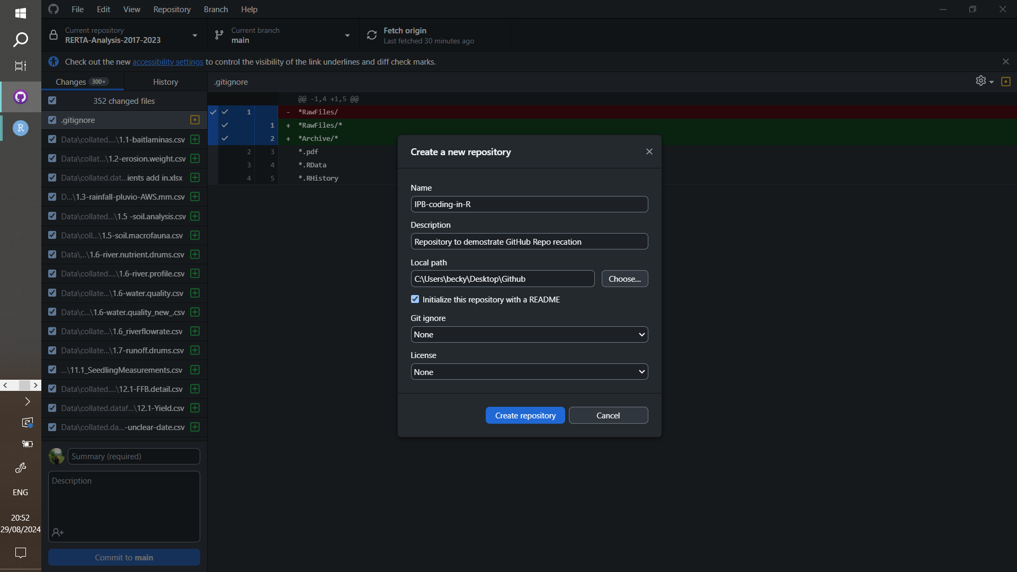
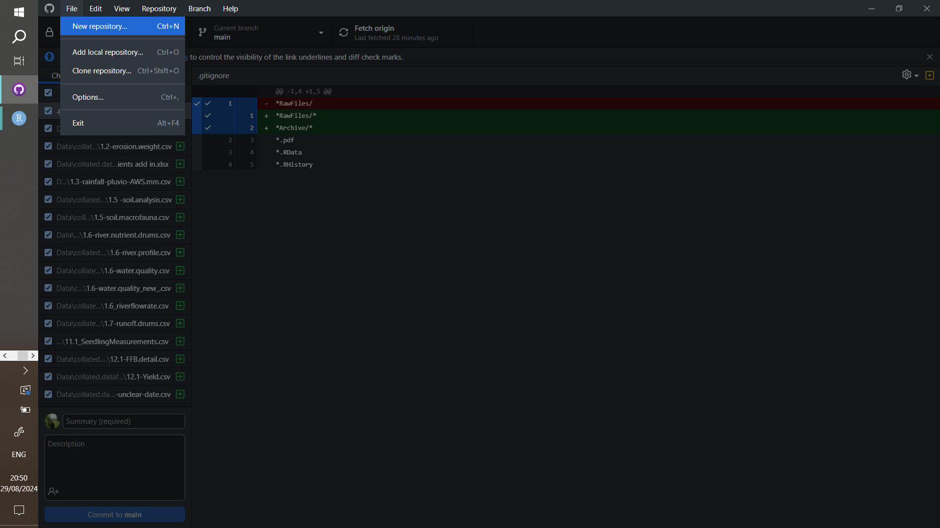
Getting started with GitHub
3) Create a new repository
@Becky_Heath rh862@cam.ac.uk

Slide 35
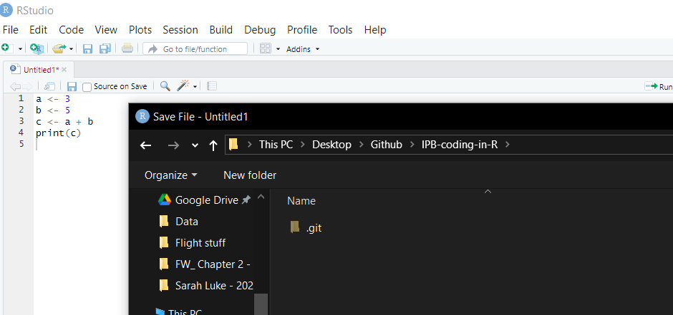
Getting started with GitHub
4) Save R file to new repo
@Becky_Heath rh862@cam.ac.uk

Slide 36
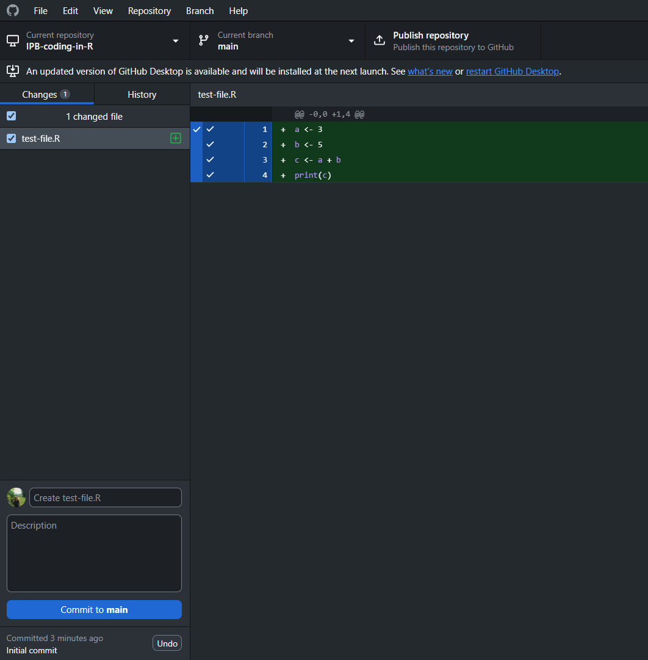
Getting started with GitHub
5) Check that the new file/ edits have been picked up by github desktop
@Becky_Heath rh862@cam.ac.uk

Slide 37
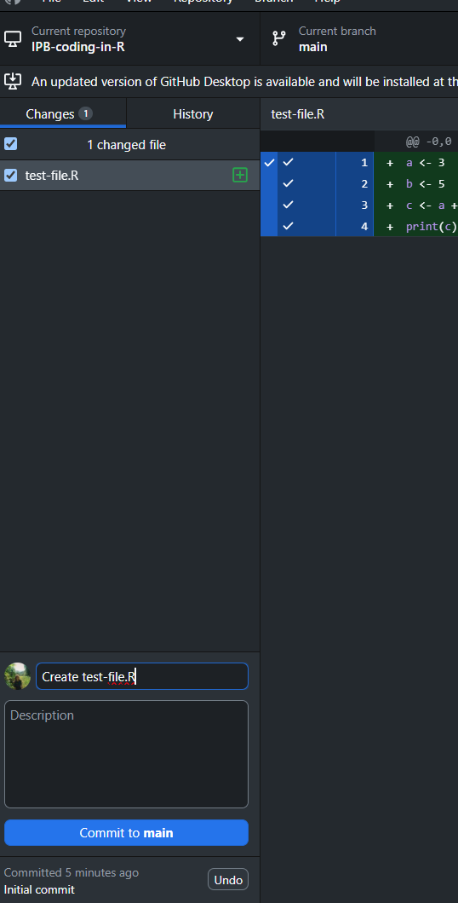
Getting started with GitHub
6) Write a description for the commit (try to be informative!)
@Becky_Heath rh862@cam.ac.uk

Slide 38
GitHub Core Concepts
@Becky_Heath rh862@cam.ac.uk

Slide 39
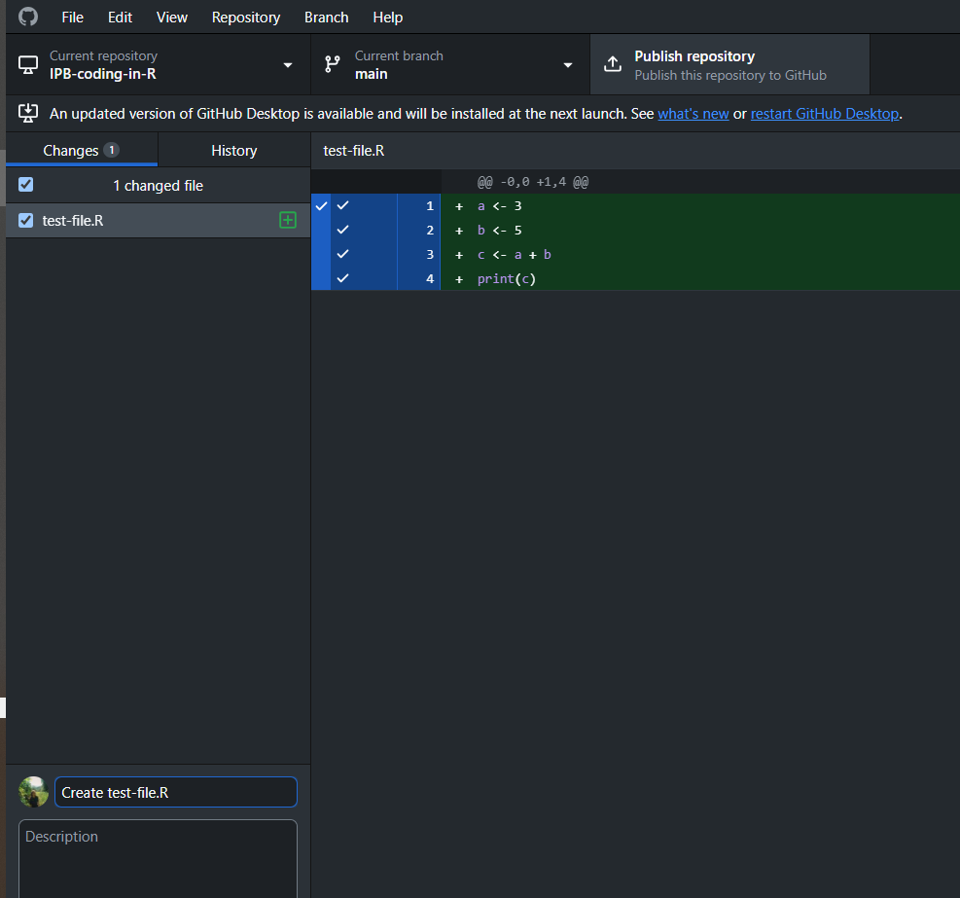
Getting started with GitHub
7) Push the commit to GitHub ☺
NB: it says publish the first time but it will say push after
@Becky_Heath rh862@cam.ac.uk

Slide 40
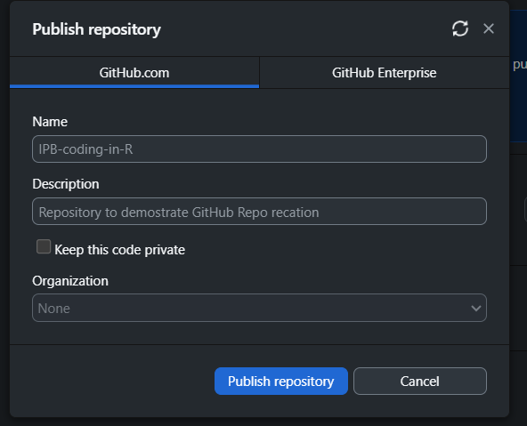
Getting started with GitHub
only the first time:
check details are correct and decide if you want the repo to be public or not
…. then publish
@Becky_Heath rh862@cam.ac.uk

Slide 41
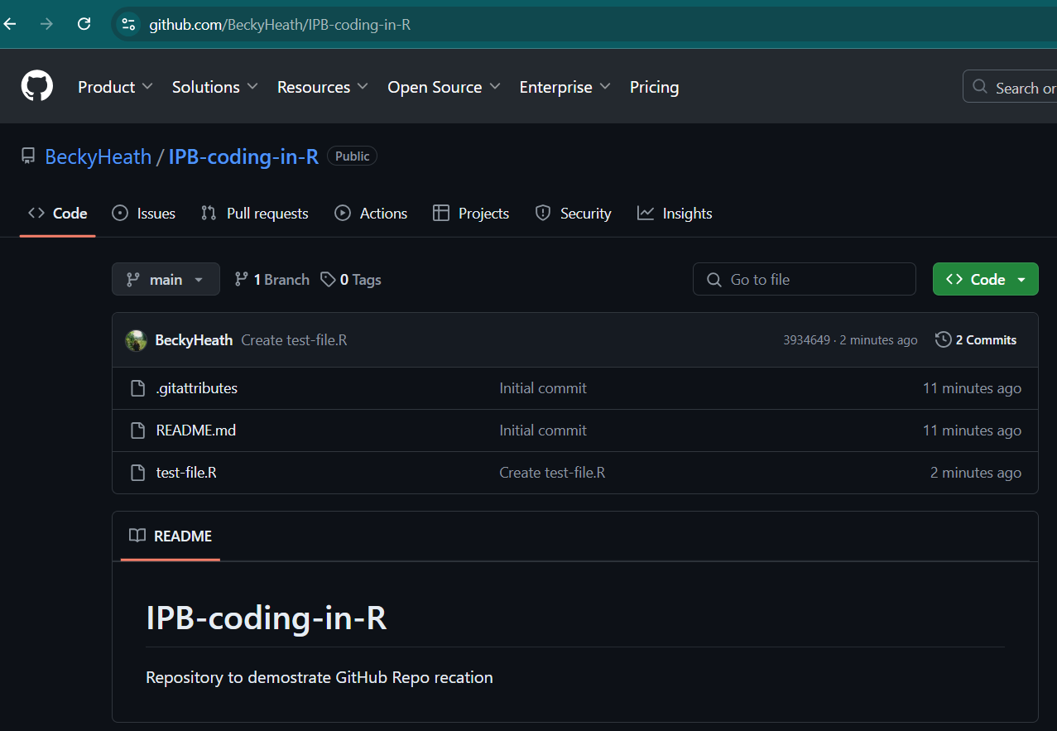
Getting started with GitHub
Check the repo is online!!
To check, go to
github.com/[USERNAME]/[REPO-NAME]
@Becky_Heath rh862@cam.ac.uk

Slide 42

This lesson’s repo
The repo created just now containing slides and links to tutorials:
https://github.com/BeckyHeath/IPB-coding-in-R
@Becky_Heath rh862@cam.ac.uk

Slide 43
Rest of the session
Introduction to coding and R
Introduction to GitHub
Plan for the rest of the session
Where to find help
@Becky_Heath rh862@cam.ac.uk

Slide 44



Plan for the rest of the session
Work through tutorials online at your own pace
Try to find solutions online (next section).
Ask for help if you can’t find a solution
@Becky_Heath rh862@cam.ac.uk

Slide 45
Where to find help
Introduction to coding and R
Introduction to GitHub
Plan for the rest of the session
Where to find help
@Becky_Heath rh862@cam.ac.uk

Slide 46
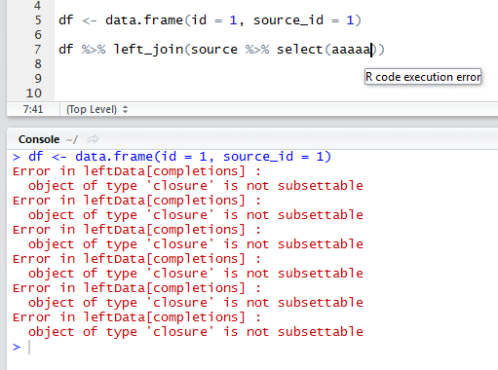
Using error messages?
The fastest and easiest way to debug code in R is to type the error message into google and test out solutions
Best to use public forums such as “cross check”, “stack overflow” and “stack exchange”.
@Becky_Heath rh862@cam.ac.uk

Slide 47

Using AI for debugging?
Chat GPT is an algorithm that is really good at picking out patterns in human language.
It is very good at sounding correct, and is very often good at finding simple solutions, but not complex issues.
Chat GPT gets stuff wrong a lot.
USE WITH CAUTION
@Becky_Heath rh862@cam.ac.uk

Slide 48
How do I get good at coding?
Practice
@Becky_Heath rh862@cam.ac.uk

Slide 49
How do I get good at coding?
Practice
… sorry ☺
@Becky_Heath rh862@cam.ac.uk

Slide 50

Selected Tutorials
Code Club (University of Edinburgh)
1- R Basics : All
2 – Data Manipulation: Basic Data Manipulation
3 – Data Manipulation: Efficient Data Manipulation
4– Data Visualisation: Basic Part1 and Part2
5 – Modelling: From distributions to Linear Models
6 – Modelling: Introduction to model design
@Becky_Heath rh862@cam.ac.uk

